Slide 1

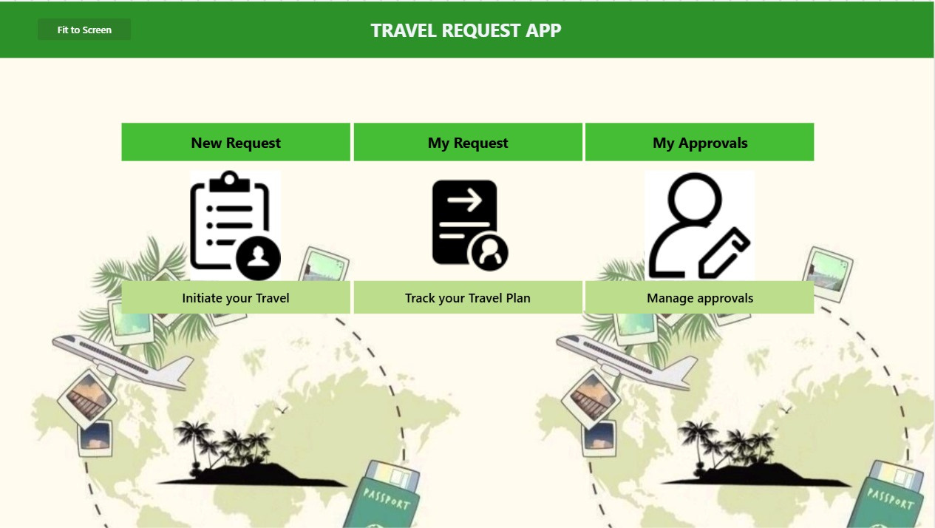

GreenMinds Industries
Travel Request Application
Using Microsoft Power Apps & SharePoint

Slide 2


Overview
Introduction
03
Problems
04
Solutions
05
Objectives
06
Travel Request Application
07
Responsive App
08
Statistics
10
Application Demo
11
Our Team
13

Slide 3

Introduction
The Travel Request Application was developed using Microsoft Power Apps to address the challenge of managing travel requests efficiently. This presentation outlines the app's features, and the value it brings by automating the travel approval workflow. Its implementation significantly improves operational efficiency, making it meaningful and relevant to modern business processes.

Slide 4

Problems
In many organizations, the travel request process is slow and cumbersome, involving manual paperwork and multiple stages of approval.
For example, an employee like Sarah may have to wait days or weeks for her travel request to be processed, with little visibility into the approval status. This can lead to delays and frustration.

Slide 5

How can we streamline the travel request and approval process to reduce the administrative burden and improve efficiency?
Solution
By implementing the Travel Request Application, the process becomes streamlined and automated, reducing administrative workload, ensuring timely approvals, and providing clear visibility throughout the approval chain. This improves efficiency, communication, and transparency, ultimately enhancing the overall workflow.

Slide 6




Objectives
Improve Data Management
Enhance Approval Efficiency
Reduce Administrative Workload
Securely store and manage request details in SharePoint for easy retrieval and audits.
Ensure faster approvals with automated notifications and task assignments.
Minimize the administrative burden by automating repetitive tasks and notifications.

Slide 7
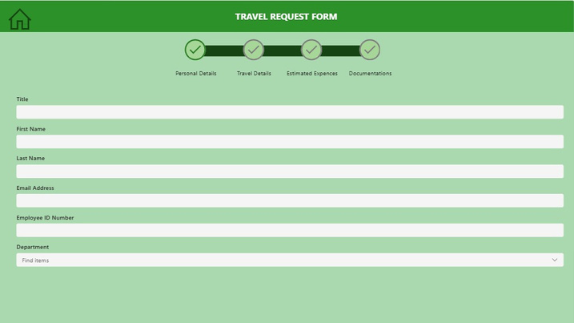
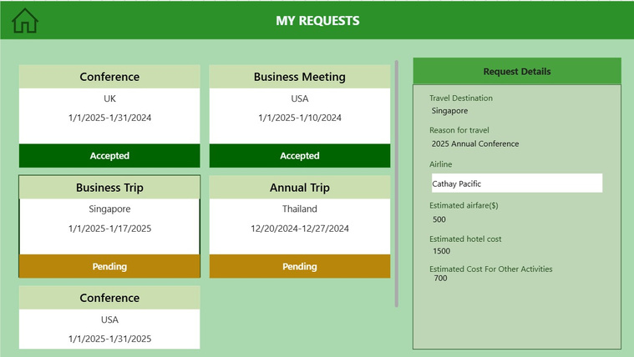
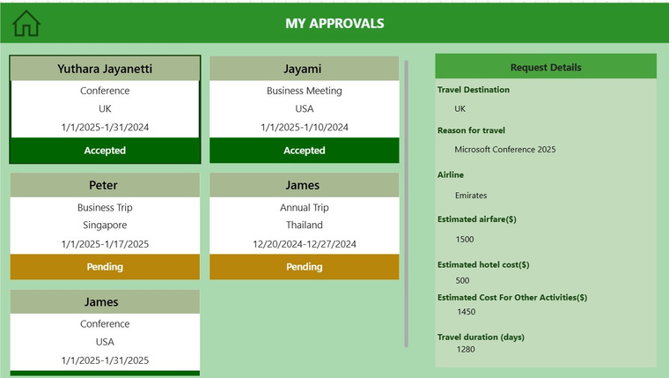
Travel Request Application
New Requests
My Requests
My Approvals
Employees can submit travel requests by filling out relevant details like destination, travel dates, and purpose.
Displays submitted requests with their current approval status (Pending, Approved, or Rejected).
Shows all requests awaiting approval, enabling approvers to review, approve, or reject travel requests.

Slide 8

Users can Navigate to Responsive App Directly from the Home screen.

Slide 9
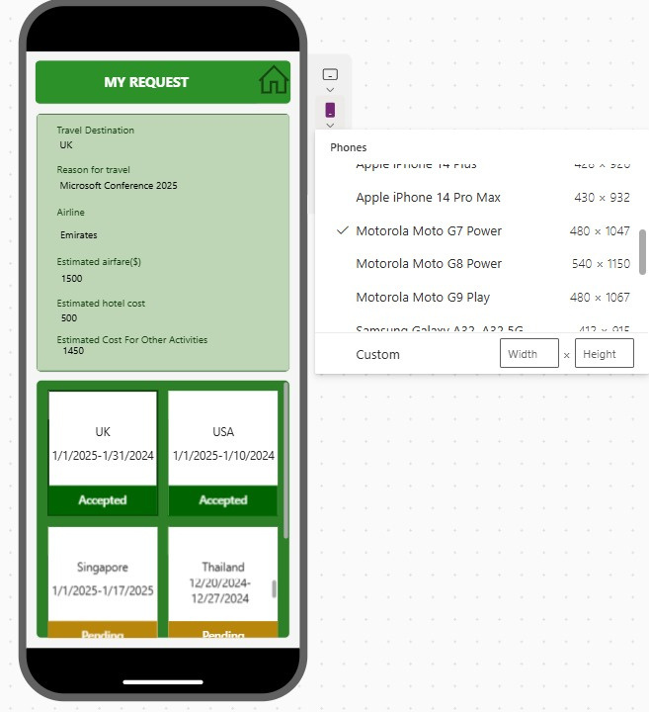
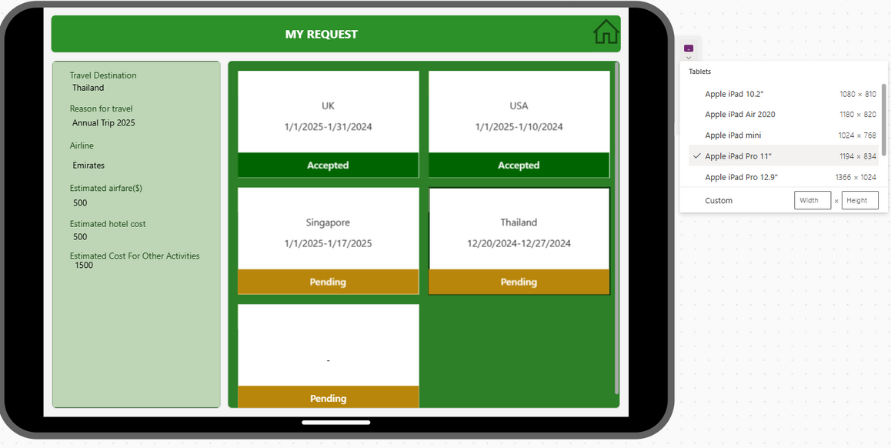

Responsive App
Phone View
Tablet View
WebPage View

Slide 10
Statistics
80%
-10%
Time Saved with App Integration
Average Approval Time
20%
75%
Growth of Total Number of Requests
Employee Satisfaction

Slide 11
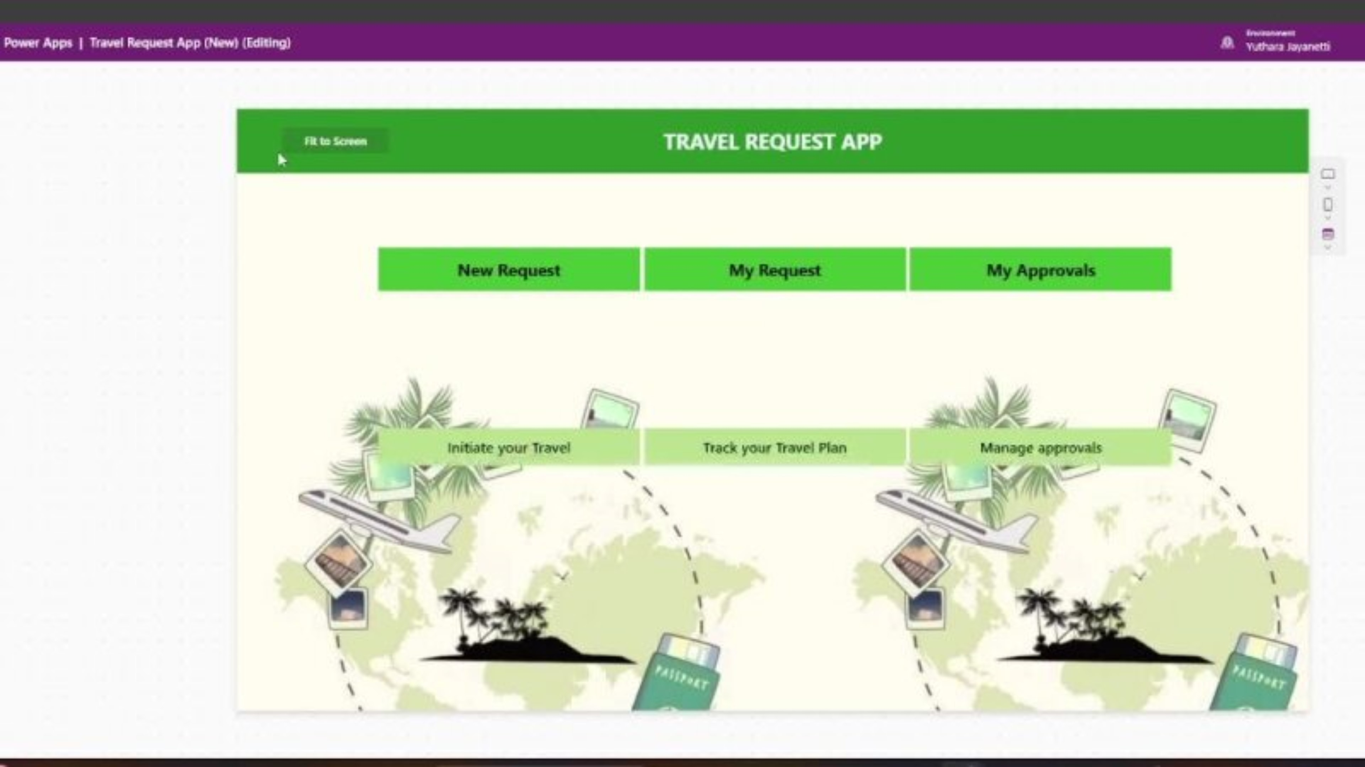
Travel Request Application - Demo
https://drive.google.com/file/d/1vqobhA70jEDxdfJYMfpk-lK_m156kL9K/view?usp=sharing

Slide 12




OUR TEAM
JKDMYY Jayanetti D/ADC/23/0023
MBF Amna D/ADC/23/0014
HTSH Samadhi D/ADC/23/0006
KGT Randika D/ADC/23/0024

Slide 13


GreenMinds
THANK YOU!

